Slide 1
PRESENTATION
FOR JUDGES

Slide 2
AGENDA
Trial Structure & The Case
Scoring, Presiding, & Commenting
Timekeeping & Other Rules

Slide 3
TRIAL STRUCTURE & THE CASE
Learning about the mock trial world

Slide 4
What is mock trial?
Mock trial is a simulation of a civil jury trial where students portray attorneys and witnesses. The trial happens in the fictional jurisdiction of Midlands, which has its own:
Case Law
Statutes
Rules of Evidence (similar to FRE)

Slide 5
This Year’s Case: MTS v. Kosack
On June 29, 2017, animal handler Danny Kosack was scheduled to appear with a chimpanzee named Elias on Midlands After Dark With Alex Grace, a late-night talk show produced by Midlands Television Studios, Inc. During a closed rehearsal for the show that afternoon, Elias attacked and killed Chris Villafana, one of the show's writers. Because of the incident, Midlands After Dark was canceled, and Kosack's animal sanctuary went out of business. MTS sued Kosack for negligence, and Kosack asserted a counterclaim against MTS for negligence as well. The trial has been bifurcated, and each round will deal solely with the issue of liability.

Slide 6
If you’ve heard this case before...
Witness selection varies from round to round. The witnesses selected by the teams will result in different availability of documentation and time to perform their parts. Do not score on these strategic choices, only on performance of what was actually presented.

Slide 7
TRIAL COMPONENTS
Pre-trial Matters / Introductions
Opening Statements
Plaintiff Case-in-Chief
Customary Break
Defense Case-in-Chief
Customary Break
Closing Arguments / Rebuttal

Slide 8
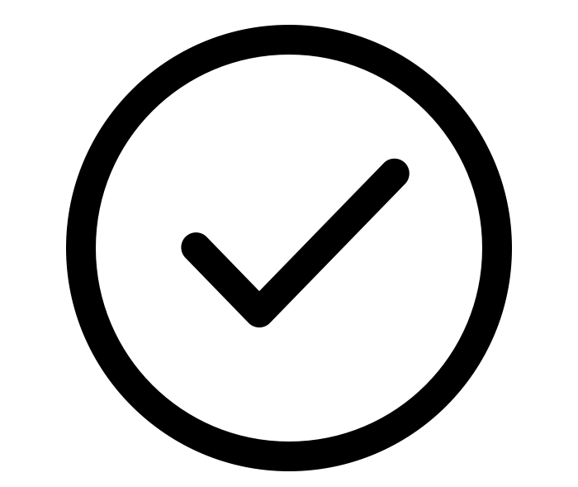
KEY TAKEAWAYS
Jurisdiction is Midlands, which has its own case law and rules of evidence
There are two customary breaks in the trial, in between each side’s case-in-chief and before closing arguments

Slide 9
PRESIDING, SCORING, & COMMENTING
How to evaluate the round

Slide 10
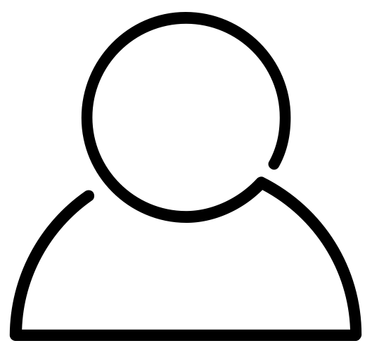
Your Role
PRESIDER
SCORER (x2)
You are here to “judge” the competition. You will do so in panels of two or more individuals.
Score
(if 2-judge panel)
Provide feedback
Preside
(rule on objections, keep trial moving)
Score
Provide feedback

Slide 11
You’re not reaching a verdict.

Slide 12
Notes for Presiders
Both teams must...
Differences from real-world trials
Present opening statements at the start of trial
Call three witnesses
Cross-examine all witnesses called

Slide 13
Notes for Presiders
NO objections to openings or closings
NO motions in limine, for a directed verdict, or mistrial
NO side bars
NO objections or questions from the judges
NO scope limitations on cross-examination (but scope is limited on re-direct and re-cross examination)
NO requirements that expert witnesses be tendered
NO binding federal precedents (e.g. McDonnell Douglas Corp. v Green does not control the burden of proof), though there is Midlands case law that the competitors will inform you of if necessary.
Differences from real-world trials

Slide 14
SCORING THE TRIAL

Slide 15
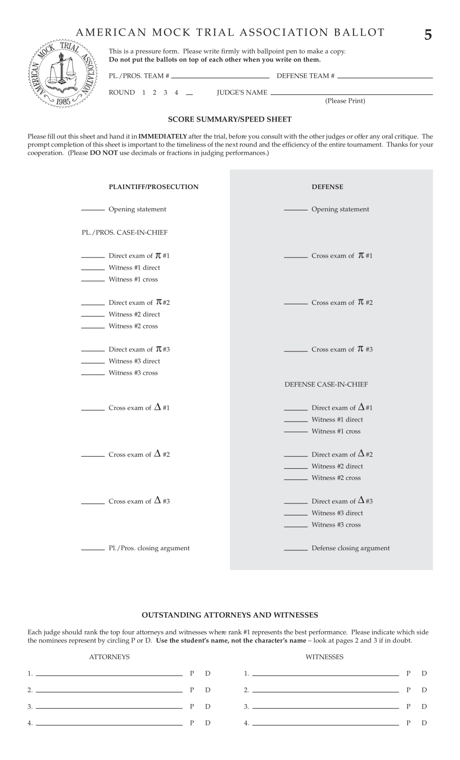
The Ballot
Ballot has 3 carbon copy pages
Don’t write on the full stack!
Be sure to set each page directly on the table to write

Slide 16
Ballot Organization
Plaintiff
LEFT
Plaintiff
RIGHT
Defense
Defense scores are shaded
Defense

Slide 17
Scoring Framework
RANGE
Score from 1-10, with 10 being the highest score
No decimals, only whole numbers
No zeros for scores
CALIBRATION
Score differences between teams
Scale doesn’t matter, just be internally consistent between sides

Slide 18
Use whole numbers, not decimals, and write legibly!

Slide 19
Using the Ballot
There are separate scores for:
-Opening statements
-Direct examinations
-Cross examinations
-Closing arguments
-Witnesses on direct/cross

Slide 20
NOTE
No separate scores for:
Pre-trial matters
Re-direct examinations
Re-cross examinations
Rebuttal
Objections
Instead, you can consider these in the corresponding scored portion (for example, the rebuttal may influence your score for closing).

Slide 21
Using the Ballot
JS
8
7
9
Score as you go!
After the Plaintiff’s case-in-chief, you should have the top half of the ballot completed and nothing else.
8
7
9
8
7
10
7
6
9
7
9
10

Slide 22
Score as you go & write scores on the ballot!

Slide 23
NOTE
There are several differences from other competitions:
Witnesses are scored
Scored on both direct and cross examination
Witnesses are allowed to wear costumes, but they’re not required
Attorneys and witnesses are allowed to use demonstrative aids (subject to objection)

Slide 24
Using the Ballot
After each witness has finished, you should have four scores filled out:
-Directing attorney
-Witness on direct
-Crossing attorney
-Witness on cross
8
7
8
7

Slide 25
Score on your own. Don’t confer with your co-judge.

Slide 26
IMPEACHMENTS
This competition has NO “invention of fact” objection, but the rules do allow for impeachment if there is an invention of fact.
Teams may NOT invent a material fact on direct-examination—such inventions are subject to impeachment.
If you believe a successful impeachment has occurred, you should reflect that in your score by penalizing the the violating team, rewarding the impeaching team, or both.

Slide 27
Individual Awards
Write the student’s REAL name, not their character
Circle P or D
Must fill out all four slots

Slide 28
PROVIDING COMMENTS

Slide 29
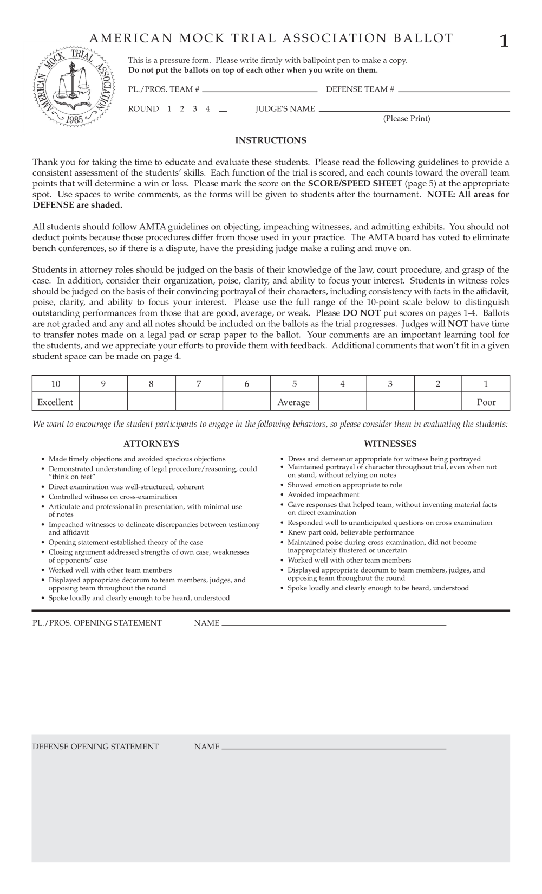
Giving Comments
All scoring judges should receive four comment sheets (these are also carbonless copy paper so may bleed!). Students will have their names / roles / team code filled out.

Slide 30
Giving Comments
Plaintiff
There are blank spaces to write comments on each part of the trial.
Non-shaded refer to Plaintiff parts
Shaded is for Defense
Defense

Slide 31
Giving Comments
Students will receive copies of the written comments after the competition
After the trial is complete, please provide a few minutes of verbal feedback

Slide 32
KEY TAKEAWAYS
Score as you go & write scores on the ballot!
Don’t confer with your co-judge
Rank individual awards, and use students’ real names
Score on performance, not the merits of the case

Slide 33
TIMEKEEPING & OTHER RULES
Keeping by the AMTA book

Slide 34
All trials must be completed within 3 hours.

Slide 35
Timekeepers
Students act as timekeepers
The trial has a 3-hour time limit, and each part of the trial has specific time limits
Please enforce time limits when you’re informed of them to not arrive at “all-loss time”

Slide 36
Anonymity & Spectators
Students’ school identity should remain anonymous until after the round
All trials are public; don’t assume the identity of the teams based on who enters the courtroom

Slide 37
AMTA Representatives
Ensure that all rules are followed
May enter the courtroom to inform you of time limit issues
May enter the courtroom to resolve conflicts students brought to their attention
Please follow their instructions!

Slide 38
Conflicts
If you have already judged a team at this particular tournament, please wait to start the trial and inform the AMTA representative
If you are affiliated with the team (i.e. your child is on the team), please wait to start the trial and inform the AMTA representative

Slide 39
KEY TAKEAWAYS
All trials must be completed in 3 hours
Keep trials moving; let students argue objections, but be aware of time limitations
Provide verbal feedback, but try to limit to 10 minutes for the entire panel to keep rounds moving
Be aware of potential conflicts

Slide 40
What happens next?
Questions & Judging Assignments!

Slide 41
Thanks!

